Slide 1
Introduction to Server-Side Development with PHP
Chapter 8

Slide 2
Objectives
1
2
Server-Side Development
Web Server’s Responsabilities
3
4
Quick Tour of PHP
Program Control
5
Functions
7

Slide 3
What IS Server-Side Development
Section 1 of 5

Slide 4
What is Server-Side Development
Hosting.
Use of a programming technology like PHP or ASP.NET to create scripts that dynamically generate content.
Consider distinction between client side and server side…

Slide 5
Comparing Server-Side Technologies
Microsoft technology
ASP (Active Server Pages).
Uses (VBScript programming language)
Can be embedded within the HTML.
Interpreted at run time(slow in comparison to other technologies.)
ASP.NET.
Part of Microsoft’s .NET Framework
Can use any .NET programming language (though C# is the most commonly used).
ASP.NET uses an explicitly object-oriented approach.
Uses special markup called web server controls that encapsulate common web functionality such as database-driven lists, form validation, and user registration wizards.
Compiled into an intermediary file format called MSIL that is analogous to Java’s byte-code. ASP.NET then uses a Just-In-Time compiler to compile the MSIL into machine executable code so its performance can be excellent.
ASP.NET is essentially limited to Windows servers.

Slide 6
Comparing Server-Side Technologies
JSP (Java Server Pages).
Uses Java as its programming language
Uses an explicit object-oriented approach and is used in large enterprise web systems and is integrated into the J2EE environment. Since JSP uses the Java Runtime Engine, it also uses a JIT compiler for fast execution time and is cross-platform.
It has a substantial market share in the intranet environment, as well as with very large and busy sites.
Node.js.
More recent server environment that uses JavaScript on the server side.
Node.js also is its own web server software(No need other web server software.

Slide 7
Comparing Server-Side Technologies
Perl.
Was the language typically used for early server-side web development.
Used in conjunction with the Common Gateway Interface (CGI( standard API for communication between applications and web server software.)
PHP.
Dynamically typed language
Embedded directly within the HTML,
Supports most common object-oriented features, such as classes and inheritance.
PHP pages are compiled into an intermediary representation called opcodes that are analogous to Java’s byte-code or the .NET Framework’s MSIL.
Stood for personal home pages.
Recursive acronym that means PHP: Hypertext Processor.

Slide 8
Comparing Server-Side Technologies
Python.
Object-oriented programming language, including being used to create web applications.
UseS in a variety of web development frameworks such as Django and Pyramid.
Ruby on Rails.
Web development framework that uses the Ruby programming language.
Emphasizes the use of common software development approaches, in particular the MVC design pattern.
It integrates features such as templates and engines that aim to reduce the amount of development work required in the creation of a new site.

Slide 9
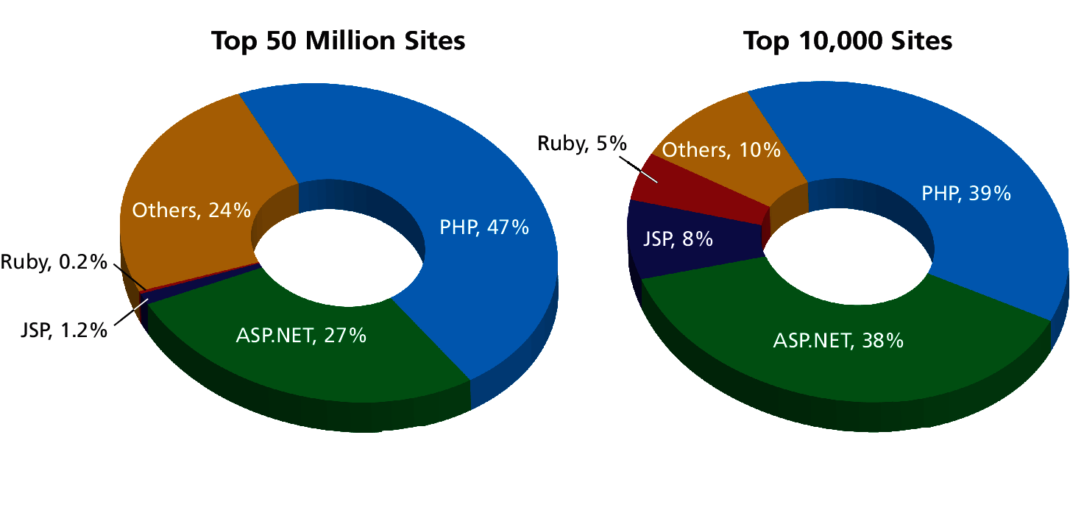
Market Share
Of web development environments

Slide 10
Web Server’s Responsabilities
Section 2 of 5

Slide 11
A Web Server’s Responsibilities
A web server has many responsibilities:
handling HTTP connections
responding to requests for static and dynamic resources
managing permissions and access for certain resources
encrypting and compressing data
managing multiple domains and URLs
managing database connections
managing cookies and state
uploading and managing files

Slide 12
LAMP stack
WAMP, MAMP, …
You will be using the LAMP software stack
Linux operating system
Apache web server
MySQL DBMS
PHP scripting language

Slide 13
Quick Tour Of PHP
Section 3 of 5

Slide 14
Quick Tour
PHP, like JavaScript, is a dynamically typed language.
it uses classes and functions in a way consistent with other object-oriented languages such as C++, C#, and Java
The syntax for loops, conditionals, and assignment is identical to JavaScript
Differs when you get to functions, classes, and in how you define variables

Slide 15
PHP Tags
Programming code can be embedded directly within an HTML file.
Extension .php
Programming code must be contained within an opening <?php tag and a matching closing ?> tag
Any code outside the tags is echoed directly out to the client

Slide 16
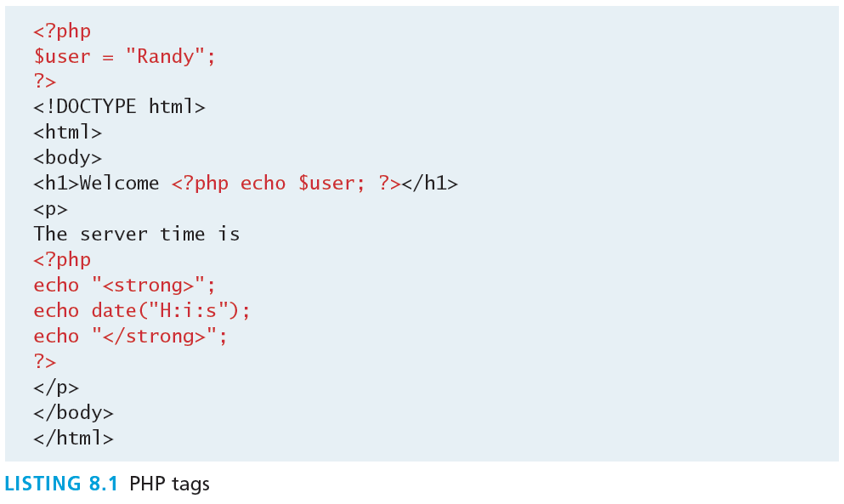
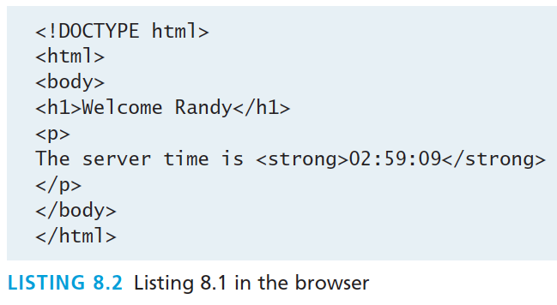
PHP Tags

Slide 17
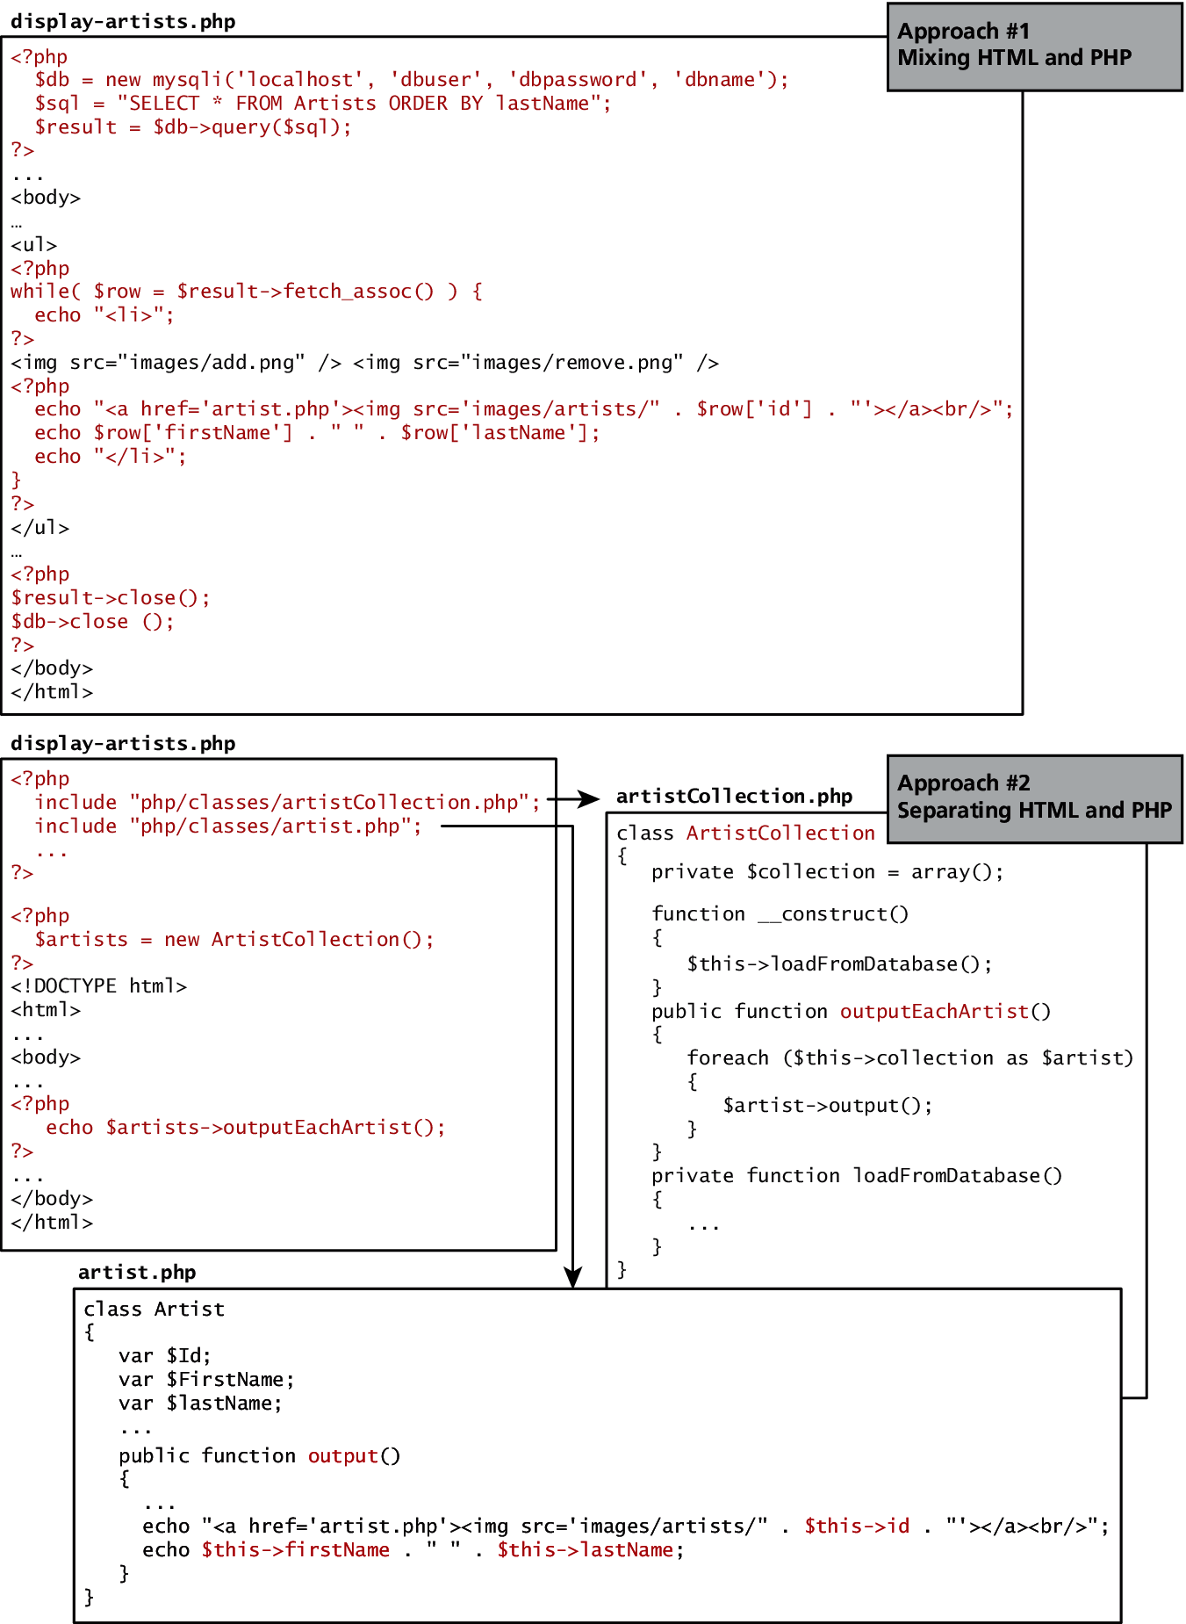
HTML and PHP
Two approaches

Slide 18
HTML and PHP
Two approaches

Slide 19
PHP Comments
3 kinds
The types of comment styles in PHP are:
Single-line comments. Lines that begin with a # are comment lines and will not be executed.
Multiline (block) comments. These comments begin with a /* and encompass everything that is encountered until a closing */ tag is found.
End-of-line comments. Whenever // is encountered in code, everything up to the end of the line is considered a comment.

Slide 20
PHP Comments
3 kinds
<?php
# single-line comment
/*
This is a multiline comment.
They are a good way to document functions or complicated blocks of code
*/
$artist = readDatabase(); // end-of-line comment
?>

Slide 21
Variables
Variables in PHP are dynamically typed.
Variables are also loosely typed in that a variable can be assigned different data types over time
To declare a variable you must preface the variable name with the dollar ($) symbol.
$count = 42;

Slide 22
Data Types
Data Type | Description
Boolean | A logical true or false value
Integer | Whole numbers
Float | Decimal numbers
String | Letters
Array | A collection of data of any type (covered in the next chapter)
Object | Instances of classes

Slide 23
Constants
Typically defined near the top of a PHP file via the define() function
once it is defined, it can be referenced without using the $ symbol

Slide 24
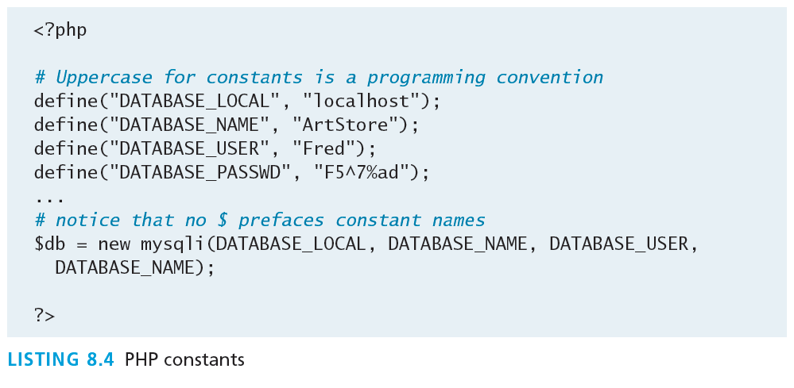
Example of Constants

Slide 25
Writing to Output
Hello World
To output something that will be seen by the browser, you can use the echo() function.
echo ("hello"); //long form
echo "hello"; //shortcut

Slide 26
String Concatenation
Easy
Strings can easily be appended together using the concatenate operator, which is the period (.) symbol.
$username = "World";
echo "Hello". $username;
Will Output Hello World

Slide 27
String Concatenation
Example
$firstName = "Pablo";
$lastName = "Picasso";
/*
Example one:
The first four lines are equivalent. Notice that you can reference PHP variables within a string literal defined with double quotes.
The resulting output for the first four lines is: <em>Pablo Picasso</em> The last one displays: <em> $firstName $lastName </em>
*/
echo "<em>" . $firstName . " ". $lastName . "</em>";
echo '<em>' . $firstName . ' '. $lastName. '</em>';
echo '<em>' . $firstName . ' '. $lastName. "</em>";
echo "<em> $firstName $lastName </em>";
echo '<em> $firstName $lastName </em>'; Won’t Work!!

Slide 28
String Concatenation
Example
/*
Example two:
These two lines are also equivalent. Notice that you can use either the single quote symbol or double quote symbol for string literals.
*/
echo "<h1>";
echo '<h1>';

Slide 29
String Concatenation
Example
/*
Example three:
These two lines are also equivalent. In the second example, the escape character (the backslash) is used to embed a double quote within a string literal defined within double quotes.
*/
echo '<img src="23.jpg" >';
echo "<img src=\"23.jpg\" >";

Slide 30
String escape Sequences
Sequence | Description
\n | Line feed
\t | Horizontal tab
\\ | Backslash
\$ | Dollar sign
\" | Double quote

Slide 31
PrintF
Good ol’ printf
As an alternative, you can use the printf() function.
includes variations to print to string and files (sprintf, fprintf)
takes at least one parameter, which is a string, and that string optionally references parameters, which are then integrated into the first string by placeholder substitution
Can also apply special formatting, for instance, specific date/time formats or number of decimal places

Slide 32
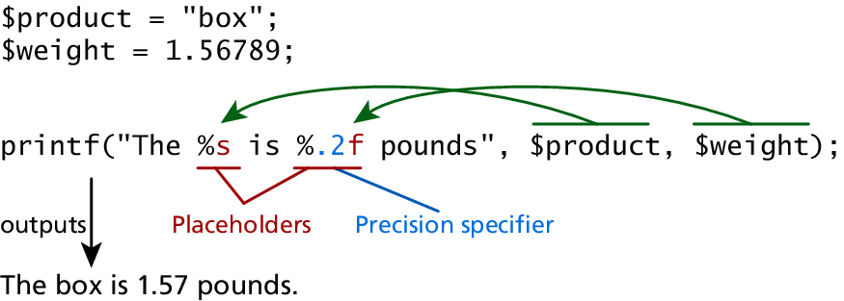
PrintF
Illustrated example

Slide 33
PrintF
Type specifiers
Each placeholder requires the percent (%) symbol in the first parameter string followed by a type specifier.
b for binary
d for signed integer
f for float
o for octal
x for hexadecimal

Slide 34
PrintF
Precision
Precision is achieved in the string with a period (.) followed by a number specifying how many digits should be displayed for floating-point numbers.

Slide 35
Program CONTROL
Section 4 of 5

Slide 36
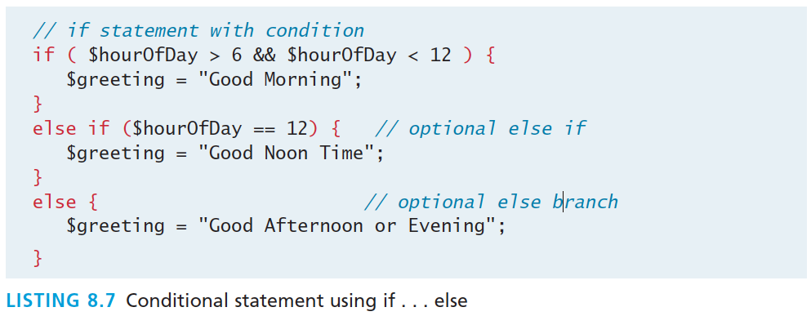
If…else
The syntax for conditionals in PHP is almost identical to that of JavaScript

Slide 37
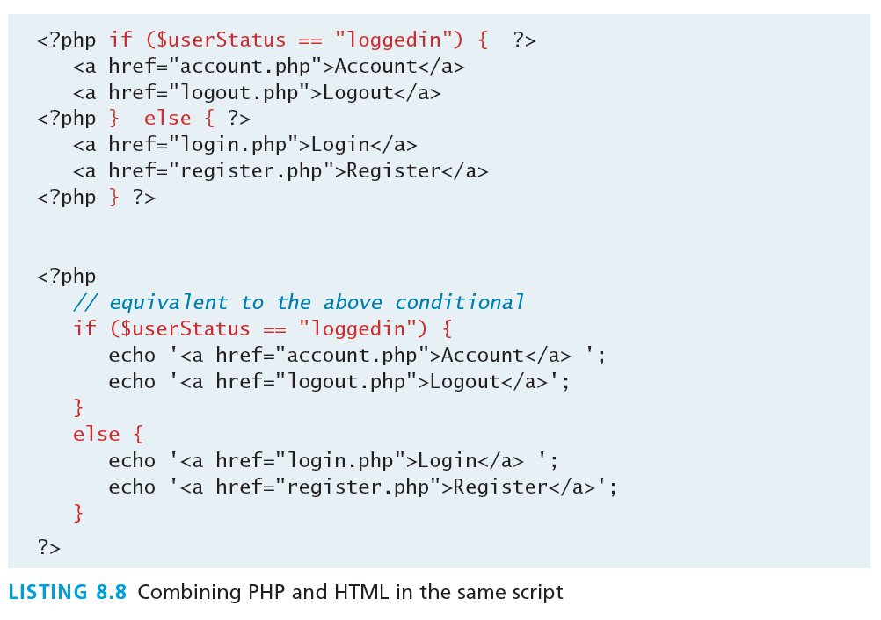
If…else
Alternate syntax

Slide 38
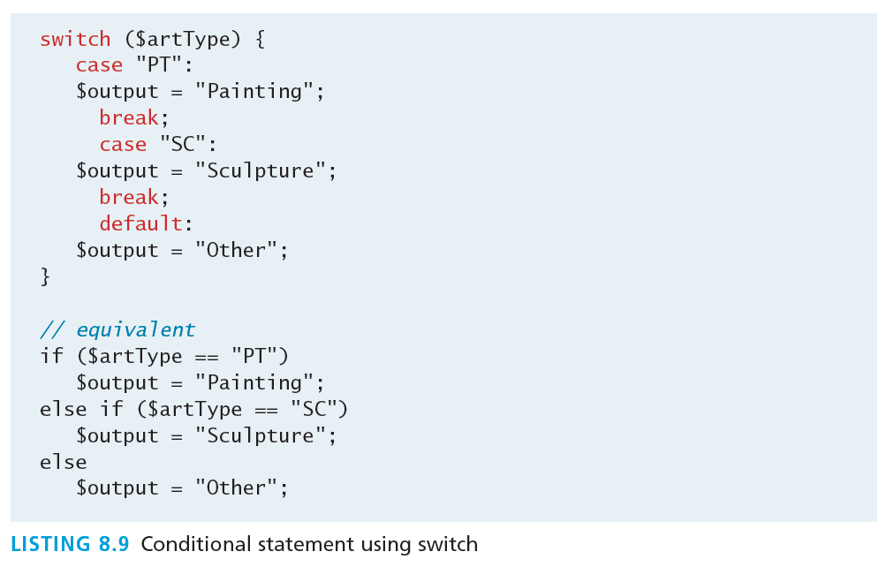
Switch…case
Nearly identical

Slide 39
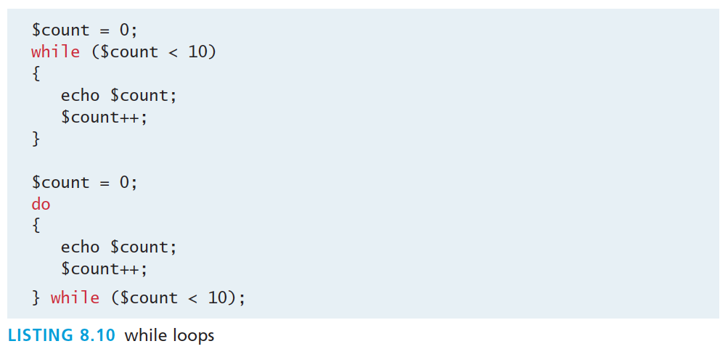
While and Do..while
Identical to other languages

Slide 40
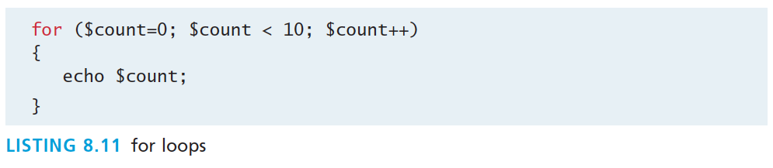
For
Identical to other languages

Slide 41
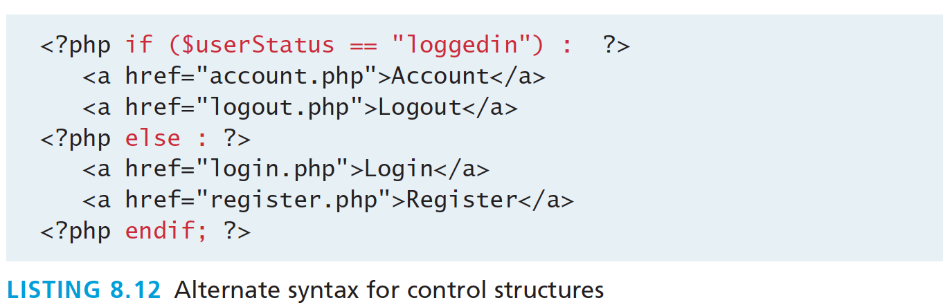
Alternate syntax for Control Structures
PHP has an alternative syntax for most of its control structures. In this alternate syntax
the colon (:) replaces the opening curly bracket,
while the closing brace is replaced with endif;, endwhile;, endfor;, endforeach;, or endswitch;

Slide 42
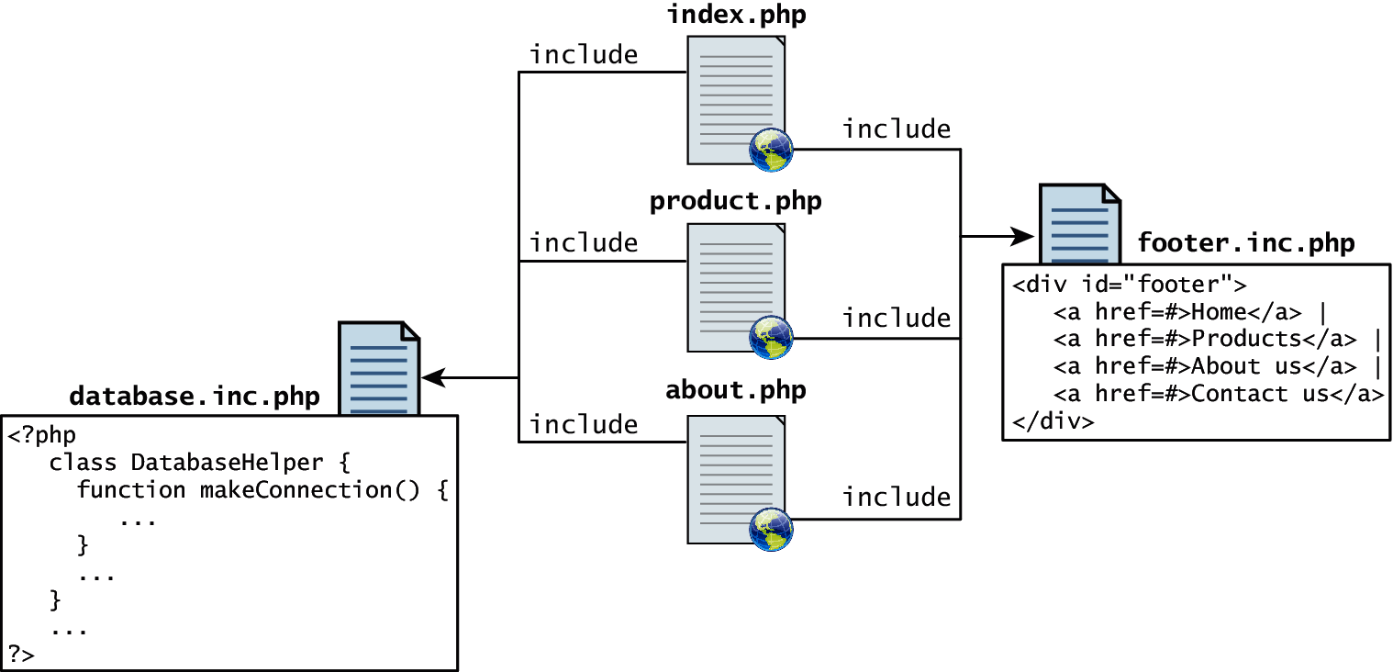
Include Files
Organize your code
PHP does have one important facility that is generally unlike other nonweb programming languages, namely the ability to include or insert content from one file into another.

Slide 43
Include Files
Organize your code
PHP provides four different statements for including files, as shown below.
include "somefile.php";
include_once "somefile.php";
require "somefile.php";
require_once "somefile.php";
With include, a warning is displayed and then execution continues. With require, an error is displayed and execution stops.

Slide 44
Include Files
Scope
Include files are the equivalent of copying and pasting.
Variables defined within an include file will have the scope of the line on which the include occurs
Any variables available at that line in the calling file will be available within the called file
If the include occurs inside a function, then all of the code contained in the called file will behave as though it had been defined inside that function

Slide 45
functions
Section 5 of 5

Slide 46
Functions
You mean we don’t write everything in main?
A function in PHP contains a small bit of code that accomplishes one thing.
In PHP there are two types of function: user-defined functions and built-in functions.
A user-defined function is one that you the programmer define.
A built-in function is one of the functions that come with the PHP environment

Slide 47
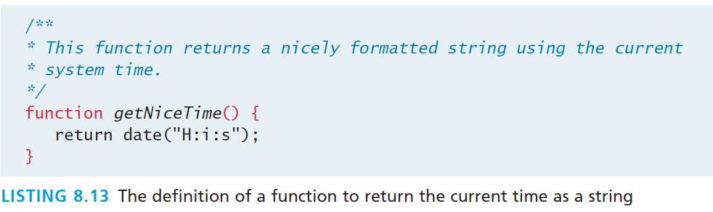
Functions
syntax
While the example function in Listing 8.13 returns a value, there is no requirement for this to be the case.

Slide 48
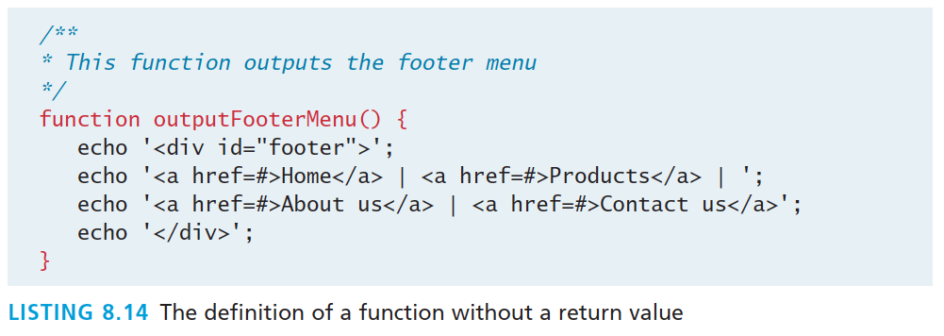
Functions
No return – no big deal.

Slide 49
Call a function
Use its name with the () brackets.
$output = getNiceTime();
echo getNiceTime();
If the function doesn’t return a value, you can just call the function:
outputFooterMenu();

Slide 50
Parameters
Parameters are the mechanism by which values are passed into functions.
To define a function with parameters, you must decide
how many parameters you want to pass in,
and in what order they will be passed
Each parameter must be named

Slide 51
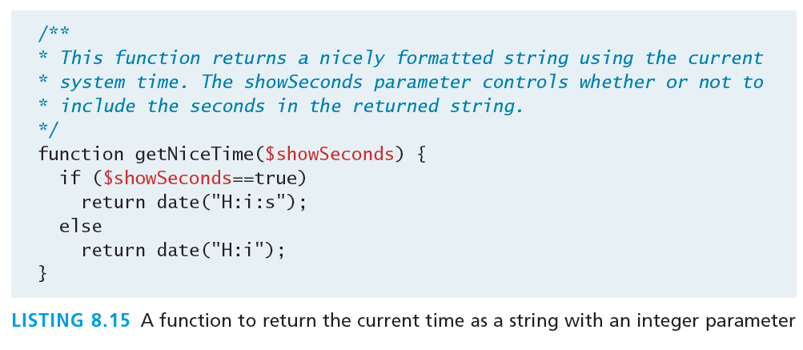
Parameters
Thus to call our function, you can now do it in two ways:
echo getNiceTime(1); // this will print seconds
echo getNiceTime(0); // will not print seconds

Slide 52
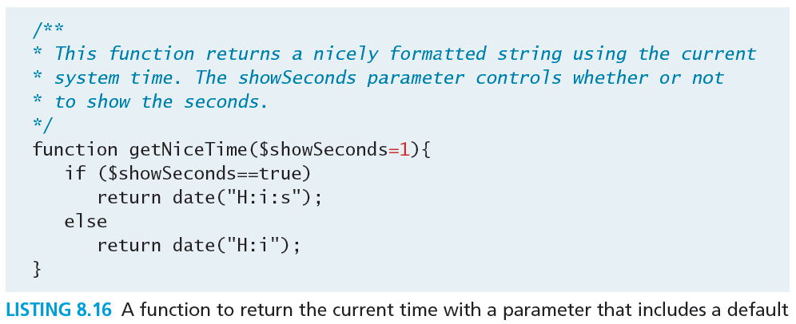
Parameter Default Values
Now if you were to call the function with no values, the $showSeconds parameter would take on the default value, which we have set to 1, and return the string with seconds.

Slide 53
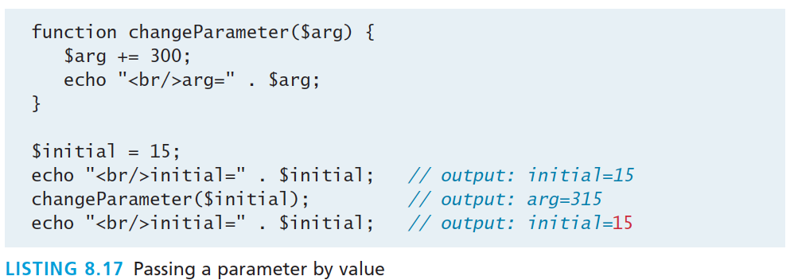
Pass Parameters by Value
By default, arguments passed to functions are passed by value in PHP. This means that PHP passes a copy of the variable so if the parameter is modified within the function, it does not change the original.

Slide 54
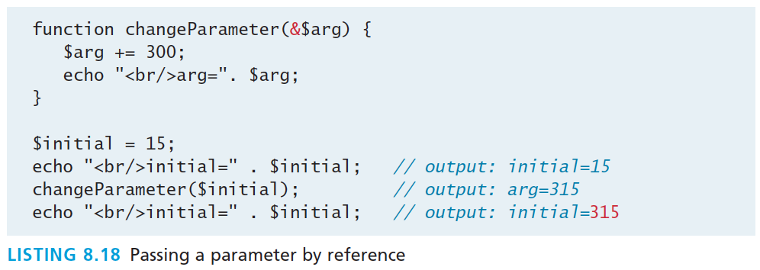
Pass Parameters by Reference
PHP also allows arguments to functions to be passed by reference, which will allow a function to change the contents of a passed variable.
The mechanism in PHP to specify that a parameter is passed by reference is to add an ampersand (&) symbol next to the parameter name in the function declaration

Slide 55
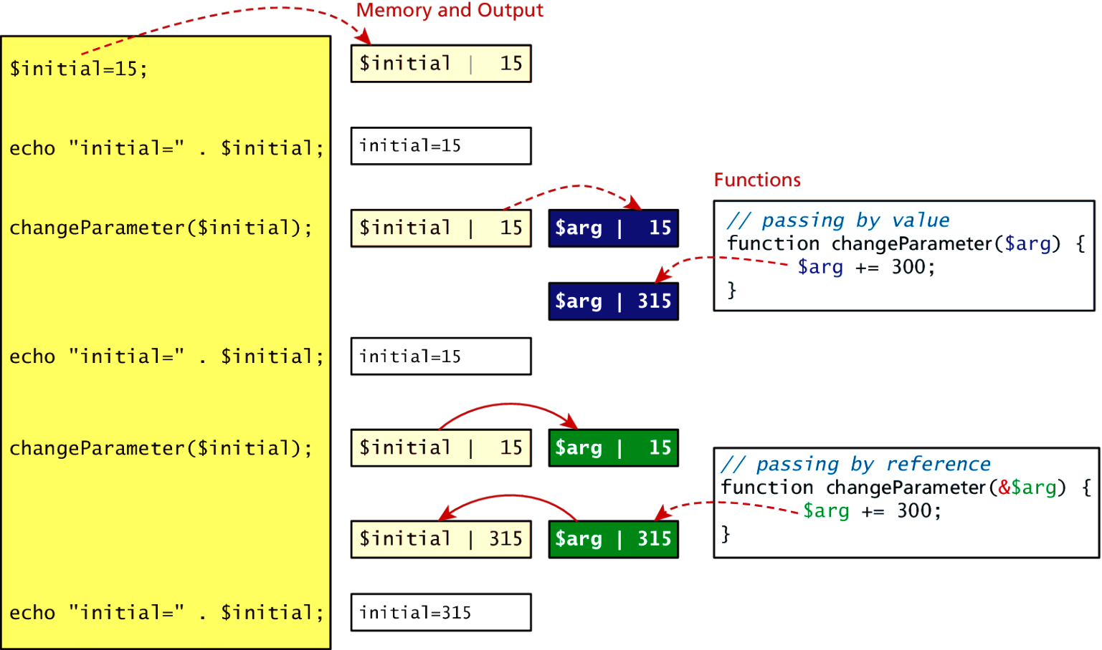
Value vs Reference

Slide 56
Variable Scope in functions
All variables defined within a function (such as parameter variables) have function scope, meaning that they are only accessible within the function.
Any variables created outside of the function in the main script are unavailable within a function.
$count= 56;
function testScope() { echo $count; // outputs 0 or generates run-time //warning/error
}
testScope(); echo $count; // outputs 56

Slide 57
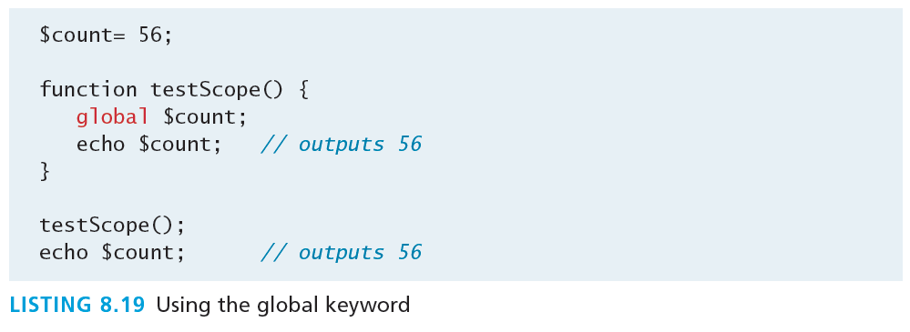
Global variables
Sometimes unavoidable
Variables defined in the main script are said to have global scope.
Unlike in other programming languages, a global variable is not, by default, available within functions.
PHP does allow variables with global scope to be accessed within a function using the global keyword

Slide 58
What You’ve Learned
1
2
Server-Side Development
Web Server’s Responsabilities
3
4
Quick Tour of PHP
Program Control
5
Functions
7

